Slide 1
Research Papers which have explored How LLMs can improve RL Applications or Convergence

Slide 2
1. iLLM-TSC: INTEGRATION REINFORCEMENT LEARNING AND LARGE LANGUAGE MODEL FOR TRAFFIC SIGNAL CONTROL POLICY IMPROVEMENT
Problem:
Traditional RL‑based traffic signal control depends heavily on available data, often missing communication failures and rare “long‑tail” events (e.g., emergency vehicles), leading to poor decisions in novel scenarios.
Proposed Approach: A Dual‑step decision loop:
RL agent selects an action based on direct observations.
LLM reviews and, if needed, adjusts the action by incorporating broader context (long‑tail events, degraded communications). (During inference)
Synergy:
RL learns environment‑specific patterns; LLM handles unexpected or rare situations.
Key Result:
This hybrid method cuts average vehicle waiting times by 17.5 % versus a pure RL controller.
Preprint in ArXiv, Mar 2024
Notes:
The eight traffic movements at the four-legged intersection (with right-turns omitted) are simply each entrance (E0–E3) doing a left turn or going straight:
E0_l (from entrance E0, turning left)
E0_s (from E0, going straight)
E1_l (from E1, turning left)
E1_s (from E1, going straight)
E2_l (from E2, turning left)
E2_s (from E2, going straight)
E3_l (from E3, turning left)
E3_s (from E3, going straight)
Observation state st∈R^{8×5} : for each of the 8 traffic movements (), the vector includes
Flow speed
Mean lane occupancy
Jam length (meters)
Jam length (vehicles)
Current phase (binary: passable or not) After transmission it’s passed through the degraded-communication model f _{degraded} to handle packet loss/noise .
Action space A=P: choose one of four signal phases {0,1,2,3} to apply for the next 5-second time slot
Phase 0: permits the straight movements E0_s and E1_s (east–west through traffic) .
Phase 1: permits the left-turn movements E0_l and E1_l (east–west left turns) .
Phase 2: permits the straight movements E3_s and E2_s (north–south through traffic) .
Phase 3: permits the left-turn movements E3_l and E2_l (north–south left turns)
----------------------------------------------------------------------------------------------------------------------------------------------------------
Key Novelty: The key novelty of iLLM-TSC is that it layers a pretrained LLM at inference time on top of a standard RL-based traffic controller in a dual-step loop: the PPO agent first proposes a signal phase, then GPT-4 “reviews” that choice via a structured natural-language prompt and can adjust it on the fly. This plug-and-play design combines RL’s environment-specific learning with the LLM’s broad reasoning—boosting robustness to noisy sensors and rare events—without retraining either model or altering the core RL pipeline

Slide 3
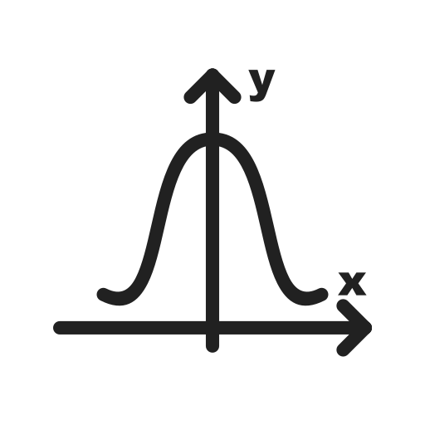





The paper focuses on MDP under two practical scenarios:
Imperfect state due to communication degradation
Situations unaccounted for by Reward function R, such as emergencies (long-tail events)
Policy Network – Probability over actions
Action a_{t =} a_{t}
Reasonable
Apply to environment and observe S_{t+1}
Action a_{t} gets suggested by the policy
State information
Communication degradation
Reinforcement learning – PPO works both for continuous and discrete space
Value Network – expected return over the action
Action a_{t =} a`_{t}
Unreasonable
LLM Evaluates whether the new state information given a_{t} is reasonable or unreasonable and predicts its own action a`_{t .} (Gives directly a low-level action)
New state information
Prompt Construction:
Role, hints for decision (e.g. “You are a traffic-signal expert”)
Traffic scenario description (emergency flags, degraded readings)
Logical chain of answers (“Explain why you choose this phase…”)
Decision Format (strict JSON schema)
LOOP
A rich prompt information is provided explicitly
This entire section of LLM prompt construction and LLM evaluation is only used during inference
Preprint in ArXiv, Mar 2024
Notes:
Action space A=P: choose one of four signal phases {0,1,2,3} to apply for the next 5-second time slot
Phase 0: permits the straight movements E0_s and E1_s (east–west through traffic) .
Phase 1: permits the left-turn movements E0_l and E1_l (east–west left turns) .
Phase 2: permits the straight movements E3_s and E2_s (north–south through traffic) .
Phase 3: permits the left-turn movements E3_l and E2_l (north–south left turns)
----------------------------------------------------------------------------------------------------------------------------------------------------------
Key Novelty: The key novelty of iLLM-TSC is that it layers a pretrained LLM at inference time on top of a standard RL-based traffic controller in a dual-step loop: the PPO agent first proposes a signal phase, then GPT-4 “reviews” that choice via a structured natural-language prompt and can adjust it on the fly. This plug-and-play design combines RL’s environment-specific learning with the LLM’s broad reasoning—boosting robustness to noisy sensors and rare events—withoutretraining either model or altering the core RL pipeline

Slide 4
Overall Architecture of iLLM - TSC
What happens in the heart of iLLM-TSC
Pure RL learning, no LLM: We first train a traffic-signal agent with.
RL proposes, LLM reviews: At each step during inference, the trained policy picks a action; we package that suggestion plus a brief scene description translated into a five-part natural-language prompt (role, hints, scenario description, logic chain, answer format ) such that the LLM can understand into a tiny natural-language prompt .
Smart fallback: GPT-4 returns a simple JSON with its “final_action.”
The flow of the architecture
Observe the current intersection state s_{t}, which may suffer degradation (noise/packet loss).
RL policy π_{θ} proposes an initial action a₀=π_{θ}(s_{t}).
Construct the prompt Ω by encoding s_{t} and a₀ into the five-part natural language template.
Send Ω to the LLM; parse its output O_{t} to extract a “final_action” via regex. Retry up to K times if formatting fails.
Execute the selected action (LLM-refined or fallback RL), step the environment, and repeat for the next timestep.
Preprint in ArXiv, Mar 2024

Slide 5
Limitations:
LLM only used at inference (no feedback into training)
Fallback on malformed LLM output: if GPT-4 doesn’t return the expected JSON within K tries, the system simply uses the original RL
Prompt brittleness: effectiveness depends on a carefully structured natural-language prompt (role, hints, logic, format
Inference latency and cost: every decision step may invoke the LLM (with up to K retries), introducing runtime delay and extra compute/API expense.
Early-stage / limited integration: the architecture is a one-way, post-hoc augmentation (proof-of-concept) rather than a tightly coupled, end-to-end learning system
Preprint in ArXiv, Mar 2024

Slide 6
2. TeLL-Drive: Enhancing Autonomous Driving with Teacher LLM-Guided Deep Reinforcement Learning
Problem:
DRL needs too much data to learn. LLMs can give good advice but are noisy and slow.
Past attempts don’t tie LLM advice closely to what’s actually happening into the DRL policy.
Proposed Approach:
LLM “Teacher” finds similar past situations and suggests maneuvers.
DRL “Student” combines that suggestion with current input using attention and learns via PPO plus KL imitation.
Mistakes trigger reflection: corrected cases are added back to memory.
Synergy:
Teacher gives a fast safe start; Student improves and takes over as imitation weight fades.
Memory + attention lets the system use past examples in context with the current state.
Key Result:
Learns faster and safer than standard DRL; final policy is lightweight and runs in real time.
Preprint in ArXiv, Feb 2025
Notes:
Observation state: At each time step t, the agent observes
A neighbour matrix X_{t}∈R^{d×N}, where each column x_{t(i).} is a feature vector [px,py,vx,vy,θ] encoding the position, velocity, and orientation of up to N nearby vehicles.
An ego-state vector e_{t}​ describing the agent’s own position, velocity, and heading. These two parts are concatenated to form the compact observation o_{t}​. arXiv
Action space: A discrete set of five high-level maneuvers
A={Accelerate, Decelerate, TurnLeft, TurnRight, MaintainSpeed}. A={Accelerate, Decelerate, TurnLeft, TurnRight, MaintainSpeed}. Once a maneuver is chosen, a lower-level PID controller generates the actual steering and throttle commands.

Slide 7





Decision Engine
The LLM retrieves similar context/conflicts from the past using cosine similarity and creates a new prompt. Keeps only recent entries
Store correction: LLM outputs a delta-token Δm. Embed Δm to Δe using and save (zt, st, Δe, “correction”) back into Memory.
Memory context
The decision engine computes the time to conflict and the severity of the conflict
The new Prompt (P):
[FACTS], [PAST CASE], [RULES]
Recommended Action A_{LLM}
Δm
Calculate TTCP
outputs one high-level manoeuvre token
State information
(Time To Conflict Point)
If Ωt > δ, prompt:
“High risk detected. Diagnose the error and recommend a corrective maneuver.”
_{LLM Call}
The state representation gets mapped into a vector h ^{s}_{t}
The teachers action gets mapped into a vector a_{t}
PPO surrogate loss
Actor Network – Probability over actions
Self Attention
Value-Function Loss
Risk Metric
Concatenation of state vector (h ^{s}_{t} ) and LLM action(a_{t}) to get vector (h_{t})
h_{t}
Critic Network – expected return over the action
Action A_{t}
$$>$$
$$β$$
Self attention for –Mixing the signal (Trust the teacher more in some contexts, rely on raw state in others)
Entropy loss
KL Divergence loss
The KL coefficient relaxes gradually
Preprint in ArXiv, Feb 2025
Notes:
Observation state: At each time step t, the agent observes
A neighbour matrix X_{t}∈R^{d×N}, where each column x_{t(i).} is a feature vector [px,py,vx,vy,θ] encoding the position, velocity, and orientation of up to N nearby vehicles.
An ego-state vector e_{t}​ describing the agent’s own position, velocity, and heading. These two parts are concatenated to form the compact observation o_{t}​. arXiv
Action space: A discrete set of five high-level maneuvers
A={Accelerate, Decelerate, TurnLeft, TurnRight, MaintainSpeed}. A={Accelerate, Decelerate, TurnLeft, TurnRight, MaintainSpeed}. Once a maneuver is chosen, a lower-level PID controller generates the actual steering and throttle commands.
----------------------------------------------------------------------------------------------------------------------------------------------------------
What is the rationale behind the authors using self attention and single step manuevers from the LLM action?
The student network sees two inputs—its own state embedding and the teacher’s suggestion embedding.
A fixed linear merge (like simple concatenation + MLP) would force a one-size-fits-all blending. Self-attention lets the network learn
when to lean heavily on the teacher and when to rely more on raw observations, on a case-by-case basis.
Multi-Head Insights: With multiple attention heads, the model can attend to different “angles” of the teacher vs. state signals
----------------------------------------------------------------------------------------------------------------------------------------------------------
What training scenario have researchers considered
Training (Simulation) Scenarios: Built on Highway-Env and OpenAI Gym, the authors designed three progressively challenging tasks:
Unsignalized Intersection: Unprotected left-turn conflict resolution.
High-Speed Ramp Merging: Speed matching and gap selection on an acceleration lane.
Four-Lane Adaptive Cruise: Precise longitudinal control across four lanes, with varying driver profiles and 15 % speed disturbances.
----------------------------------------------------------------------------------------------------------------------------------------------------------
Key novelty:
What makes TeLL-Drive stand out is that it doesn’t just fine-tune an LLM or bolt on its advice afterward. Instead, it keeps a small “memory” of real driving experiences, pulls up the closest match to build a simple prompt, and asks the LLM for a one-step suggestion. That suggestion is woven into the student’s network via attention and the student is gently nudged to imitate it early on, then gradually left to learn on its own. On top of that, whenever the student makes a risky move, the system asks the LLM to analyze what went wrong and adds that correction back into memory—so the agent learns faster, stays safer, and ultimately runs in real time without needing the LLM at every step.
----------------------------------------------------------------------------------------------------------------------------------------------------------
Why not have the LLM spit out raw low-level commands?
Unreliable timing: LLMs run at hundreds of milliseconds per call.
Jittery behavior: Text-trained models haven’t learned smooth physics-consistent control and your aircraft will wobble.
Lack of fine-tuning: Low-level flight control lives in a very narrow, safety-critical manifold. It’s hard to get the LLM to generate exactly the right manoeuvers
Separation of concerns: By having the LLM propose a high-level intent vector (via an MLP) and then fusing that with the current state in a small neural block (self-attention or similar), you let your PPO actor learn how to execute that intent robustly—decoupling

Slide 8
Overall Architecture of TeLL-Drive
At its heart, TeLL-Drive pairs:
A Teacher—a large language model (LLM) that reasons over past examples and current situation to suggest a high-level maneuver.
A Student—a DRL agent (actor–critic) that fuses the Teacher’s suggestion with its own observations and learns a policy via a KL-penalized PPO update.
The flow is:
Observe the environment → form a state embedding
Retrieve a similar past scenario from a small memory
Prompt the LLM with “facts + past case + rules” → receive a maneuver token + chain-of-thought
Embed that token into a vector
Fuse it with the state embedding via self-attention → produce a joint feature
Actor–Critic heads use that feature to choose an action and estimate value
Train with PPO + a KL penalty tying the student to the teacher (early on)
Reflect on any high-risk mistakes → update memory with corrective cases
Preprint in ArXiv, Feb 2025

Slide 9

Limitations:
A very large memory takes longer to search for “most similar” cases, increasing compute cost and response time.
Early on, the Student may learns from less-rich memory data, which can slow down training
There is lot of dependence on the $β$ parameter in risk metric calculation. Requires careful tuning
TeLL-Drive controls only one “ego” vehicle at a time; other cars are treated as background actors.
If the LLM is slow (high latency) or gives a bad suggestion (hallucinates), the vehicle’s safety and responsiveness suffer.
Preprint in ArXiv, Feb 2025

Slide 10
Proposed Idea
The problems which we are addressing through limitations identified in iLLM-TSC, TeLL-Drive:
iLLM-TSC overrides the LLM actions only at inference time, leaving the policy under-exposed.
iLLM-TSC proposes a single-step overrides rather than sustained guidance until the end.
TeLL-Drive trains the student policy using LLM for the initial 10% of total episodes. However, for long-tail event handling this may not be essential we just need to inject the long-tail events events into the initial training phase
Proposed idea’s key novelty would be:
Guiding the DRL policy during training with fewer number of LLM calls only where it matters the most i.e. focusing on long-tail event handling, unlike the TeLL-Drive which invokes LLM call for initial 10% of episodes.
Notes:
Drawbacks of TeLL-Drive which we are overcoming:
Teacher-only early training It calls the LLM for the first 10 % of episodes then goes silent—so it can’t help on late-learning edge cases or at inference time. We fix it by triggering LLM guidance on demand (via an adaptive risk gate) both during training and in live deployments.
Hard threshold β It uses one fixed risk cutoff to decide when the LLM steps in, which either over-calls or under-calls help as the policy changes. We fix it by making β adaptive (running percentile or stakes-scaled), so we always intervene only on truly critical moments.
Single-phase, training-only plans It merges LLM advice into training via attention but never asks for sustained, multi-step guidance that covers both conflict avoidance and merge-back. We fix it by getting a two-phase plan (conflict resolution + route return) and executing it end-to-end before handing back to PPO.
iLLM-TSC’s main shortcomings
Inference-only intervention It doesn’t call the LLM during training, so the policy never learns from those overrides.
No memory distillation via vector database It retrieves examples but never distills successful plans into reusable “skills,” so it keeps re-calling the LLM for the same patterns. We fix it by caching and reusing distilled skills, drastically cutting down future LLM calls without losing performance.

Slide 11
Architectural flow of the proposed idea:
Run environment: Simulate traffic with predefined long-tail events (storms, emergencies, no-go incursions) etc.
Detect crisis: if a long-tail trigger fires, compute risk score Ω and compare to adaptive threshold β.
Decide:
If low risk and no long tail event: student PPO acts normally.
If high risk and presence of long tail event: attempt to reuse a similar cached skill from memory and query the LLM. (Query even if no related cache is present)
LLM guidance: Prompted with current state + similar past cases; returns a multi-step macro-plan in two phases.
Execute plan: Apply the macro-plan until its stop condition is met or it fails.
Skill distillation to DRL policy to avoid future LLM calls.
Memory & threshold update: Store high-risk episode details, adapt threshold β (mentioned in TeLL-Drive) over time as student competence grows.
Notes:
Why the 2-step plan would work, compared to low-level action?
Clear plan encoding: your MLP must turn “+30°” into a distinct vector the network can’t ignore.
Consistent repetition: running the same plan-vector through the fusion and actor for all 10 steps keeps the network focused on the same goal, rather than flicking between many targets
By feeding the plan-vector into the policy at every step and softly penalizing action choices that don’t move you toward the plan’s heading, PPO gradually learns the exact low-level controls needed to fulfil any high-level instruction like “+30° for 10 steps.”

Slide 12
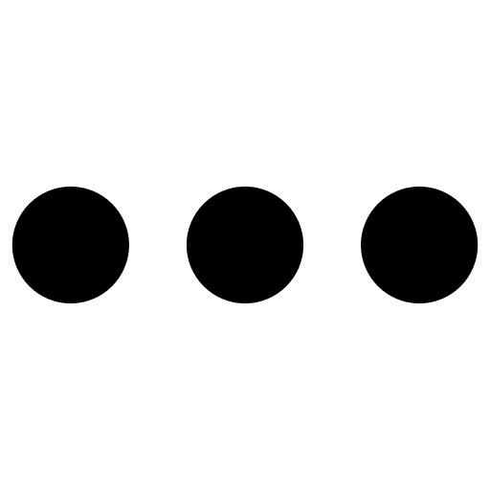






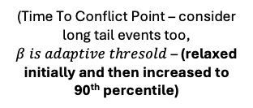

Proposed Architectural Flow:
Decision Engine
The LLM retrieves similar context from past and creates a new prompt. (Memory capacity capped at 40)
Memory context
Store correction: LLM outputs a delta-token Δm
(Time To Conflict Point – consider long tail events too, $β is adaptive thresold$ – (relaxed initially and then increased to 90th percentile)
Prompt the LLM to yield, in JSON, a two-phase manoeuvre that first resolves the conflict, then returns the aircraft to its planned route. Execute LLM-derived High-level action for phase 1. And then initiate phase 2
Compute risk score > $β$
The new Prompt (P):
[FACTS], [PAST CASE], [RULES]
Recommended Action A_{LLM}
(LLM Invocation Flag –TRUE)
Δm
Yes > $β$
Outputs multi-step high-level Manoeuvre tokens
State information + Padded vector for long tail events
“T” Latent loops of self-attention (2-3) before fixating on the same embedding (iterative refinement)
When phase 1 is over
_{LLM Call}
Self attention for – Mixing the signal
The LLM multi-step action of the respective state is mapped into a vector a_{t}
The state representation gets mapped into a vector h ^{s}_{t}
Once the agent reaches within a threshold (CTD ≤ δ)
Then continue with PPO policy. Mark CR Flag = TRUE
Yes > $β$
Self Attention
PPO surrogate loss
If the conflict is resolved
(CR = TRUE) AND CTD ≤ δ within k steps, then CR WAS SUCCESFULL
h_{t}
Actor Network – Probability over actions
Value-Function Loss
No < $β$
Successful
Entropy loss
Action A_{t}
Check LLM invocation flag
Yes
Critic Network – expected return over the action
Failed call
If after k steps of phase 1, CTD is still increasing then CR was unsuccessful
KL Divergence loss
The KL coefficient relaxes gradually
$$=$$
Loss _{Total}
Notes:
1. How are we calculating risk scores and the presence of long tail events?
Ω=w1 × $\frac{\text{1}}{\text{separation}}$ + w2 × $\frac{1}{\text{TTC}}$ + w3×storm_flag + w4×emergency_flag + w5 ×comms_flag + w6 ×no_go_flag
A fixed threshold (say “risk > 5”) might be too blunt:
Early in training, most situations are risky → you’d call the LLM constantly.
Later, the student gets better → almost no situation exceeds that same “5” → you’d never use the LLM again.
An adaptive threshold evolves as the agent learns:
Collect recent risk scores (Ω values) in a sliding window.
Recompute β as, for example, the 90th percentile of that window.
That means “only the worst 10% of cases” trigger help.
Optionally adjust for special flights (scale β down when it’s an emergency so you ask help sooner).
---------------------------------------------------------------------------------------------------------------------
2. Why do we seek high level action actions and not execute low level actions from the LLMs?
Direct Low-Level LLM Actions
No learning signal: Actions spit out by the LLM aren’t part of the policy’s parameterized distribution, so PPO can’t compute gradients to reproduce them—no way for the student to “learn” from those moves.
Jitter & Inconsistency: LLM outputs vary each call leading to unstable controls and making it hard for a high-frequency controller to track.
Embedding → Self-Attention → PPO Sampling. Letting PPO sample from its own distribution—KL-distillation anchors those samples to the plan, providing a direct gradient signal.
---------------------------------------------------------------------------------------------------------------------
3. Why don't we have single step manoeuvres recommended by the LLM?
When the LLM hands you a goal (“Hold +30° for next 10 steps”), we can see how well that goal worked over several steps and teach the agent accordingly. If it just gives single actions, it’s hard to know which ones actually solved the problem.
---------------------------------------------------------------------------------------------------------------------
4. Why just one attention block per step?
A single attention module is enough to let the model focus on whichever parts of the LLM plan or the current state matter most when choosing an action.
---------------------------------------------------------------------------------------------------------------------
5. Why hold the same plan embedding for N steps?
We want LLM plan to stay in effect for the full horizon, not vanish after one step. Keeping the plan vector constant makes sure each action is guided by the same instruction. If we refreshed or changed the embedding every step, we'd either need to re-call the LLM or risk drifting intent.
---------------------------------------------------------------------------------------------------------------------
6. How do we encode phase -1 and phase-2 separately such that the learning signal doesn't get intermixed?
We get clean hand-off: when phase 1 ends, we simply swap to the new embedding for phase 2.
Self-attention still only ever sees one plan-vector at a time, so it’s always a single attention fusion per step.
---------------------------------------------------------------------------------------------------------------------
7. How to use embeddings over N steps
Get both plans at once LLM returns something like:
{ "phase1": { "action":"+30°", "horizon":8, "stop":"sep≥5NM" }, "phase2": { "action":"–20°", "horizon":6, "stop":"XTD≤1NM" } }
Encode separately
Run phase1 text through your plan-MLP → plan-vector₁.
Run phase2 text through the same plan-MLP → plan-vector₂.
At each real step
If still in phase 1 (haven’t met its stop condition and haven’t hit 8 steps): • Fuse state-vector + plan-vector₁ via self-attention (with 2–3 loops) → decide action.
Otherwise, switch to phase 2: • Fuse state-vector + plan-vector₂ → action, until phase 2’s stop or 6 steps lapse.
Why this works
You maintain consistency: for each phase you hold a single plan-vector constant across its entire horizon.
You get clean hand-off: when phase 1 ends, you simply swap to the new embedding for phase 2.
Self-attention still only ever sees one plan-vector at a time, so it’s always a single attention fusion per step.
---------------------------------------------------------------------------------------------------------------------
8. Why do we use self- attention, not cross attention?
self-attention over the concatenated [state; plan] lets you mix both inputs in one shot with a single module. Cross-attention would require separate “query” vs. “key/value” pathways, increasing code and parameter overhead. Self-attention reuses the same weights for all interactions; cross-attention doubles up (you need separate projections), so it’s costlier per step.
---------------------------------------------------------------------------------------------------------------------
9. Do we need a memory context for the LLM in the beginning or can we start with no-data?
We can start with zero memory entries. Just give the LLM the bare essentials and let the first few successes build our case base.
CURRENT SITUATION:
• Aircraft A vs B: bearing 45°, 4 NM apart, closing at 300 kt
• Weather: storm cell 10 NM east
• Emergency flag: false
• Desired exit heading: 270°
RULES:
– Keep at least 5 NM separation
– No-go zone east of waypoint X
– Return to 270° once conflict is cleared
TASK:
1. Suggest a two-phase recovery plan in JSON:
• Phase 1: how to avoid the conflict (action, max steps, stop condition)
• Phase 2: how to merge back (action, max steps, stop condition)
2. Estimate steps for each phase.
Return only valid JSON.
---------------------------------------------------------------------------------------------------------------------
10. If there is already behaviour conformed data policy with us. How can we train a new policy and transfer its knowledge to the old one?
1. Sequential transfer (pretrain → fine-tune)
Pretrain on your behaviour-conformance data
Use standard behaviour cloning or RL on your logged “normal” flights until your policy reliably mimics ATCO style.
Freeze or regularize core layers
Lock the early layers of the network (the ones that learn general flight skills), or add a weight-penalty (EWC) so they don’t drift too far.
Fine-tune on long-tail events with LLM guidance
Plug in the LLM-assisted intervention pipeline for rare crises.
Use a KL-penalty against the pretrained policy’s outputs on normal episodes so you don’t lose your conformance behaviour.
Merge back
Optionally distil the fine-tuned network back into a single “unified” policy by rolling out mixed normal + crisis scenarios and retraining a fresh student.
Pros:
Keeps your trusted base intact.
Faster to get long-tail skills without re-training everything.
Cons:
Risk of “rigid” lower layers that can’t adapt to new crisis features.
---------------------------------------------------------------------------------------------------------------------

Slide 13
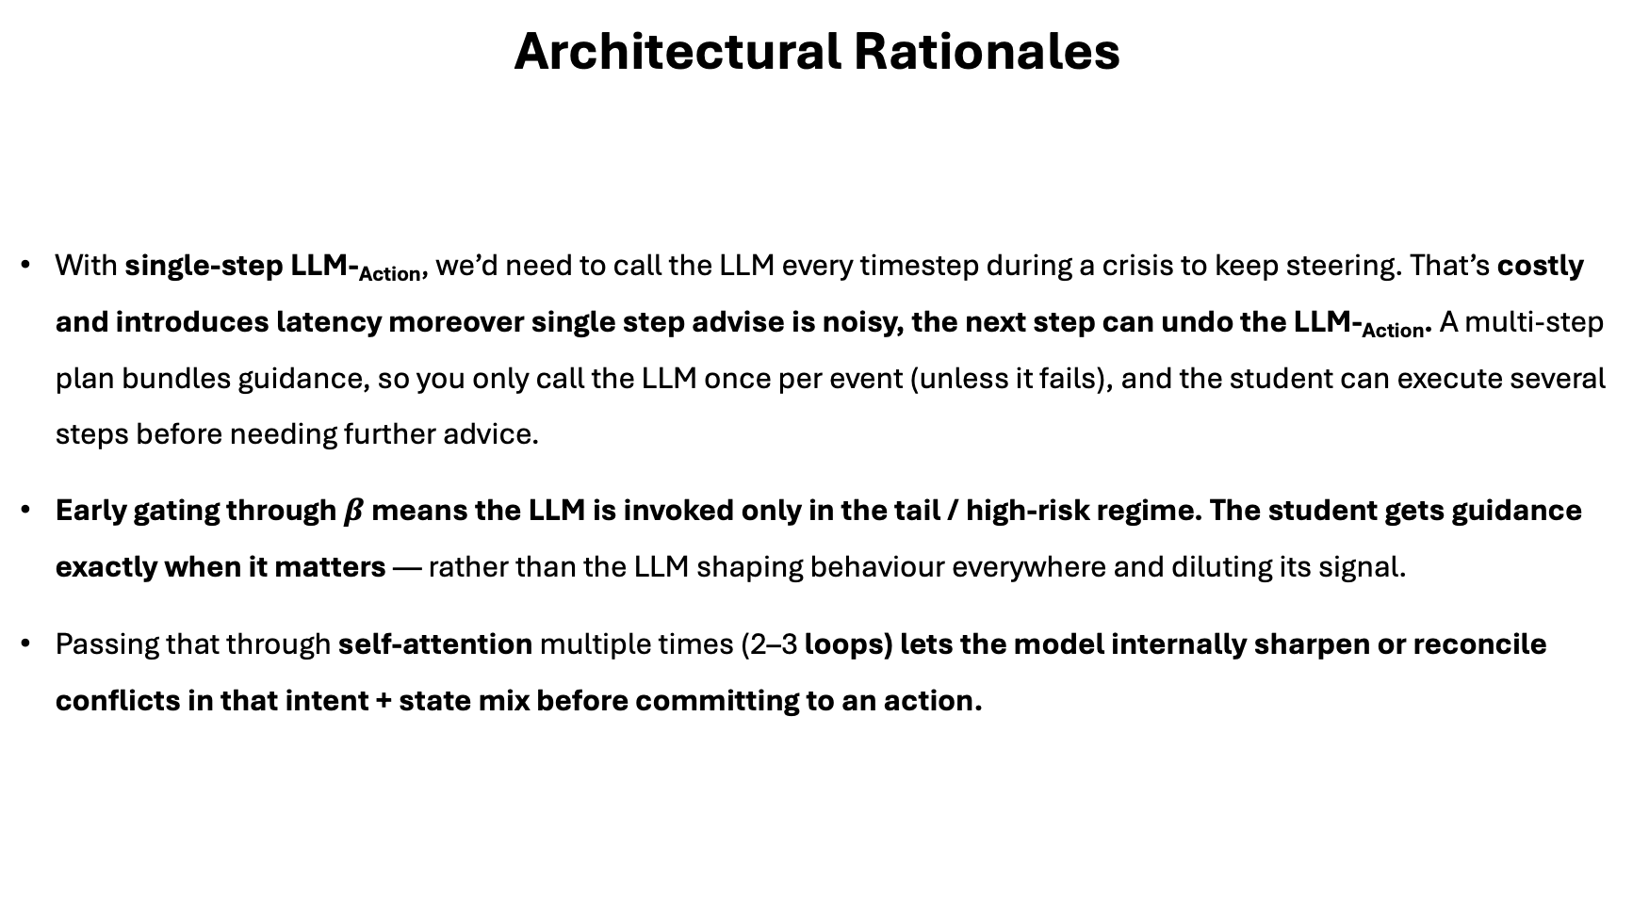
Architectural Rationales
With single-step LLM-_{Action}, we’d need to call the LLM every timestep during a crisis to keep steering. That’s costly and introduces latency moreover single step advise is noisy, the next step can undo the LLM-_{Action}. A multi-step plan bundles guidance, so you only call the LLM once per event (unless it fails), and the student can execute several steps before needing further advice.
Early gating through $β$ means the LLM is invoked only in the tail / high-risk regime. The student gets guidance exactly when it matters — rather than the LLM shaping behaviour everywhere and diluting its signal.
Passing that through self-attention multiple times (2–3 loops) lets the model internally sharpen or reconcile conflicts in that intent + state mix before committing to an action.

Slide 14
Experiment Design:
Three Objectives:
Evaluate whether sparse long-tail event injections + targeted LLM guidance improve robustness.
Measure efficiency: how much LLM intervention is actually needed (calls per episode) to achieve gains.
Ablate the contribution of prompt richness and scenario difficulty.
Axes of Variation:
Prompt Levels (inspired by iLLM-TSC):
Level 1 (Basic): Only essential high-level instruction (e.g., “Maintain safe separation”).
Level 2 (Contextual): + domain constraints (weather presence, no-go zones, emergency priority flags).
Level 3 (Full): + retrieved similar past cases, explicit termination criteria, controller preferences (e.g., minimize deviation).
Scenario Tiers (inspired by TeLL-Drive’s complexity hierarchy):
Simple conflict: Two-aircraft crossing without external disturbances.
Compound stress: Chain conflicts with a nearby thunderstorm cell or degraded comms.
High-stakes blended long-tail: Emergency priority flight + navigation failure + dynamic no-go zone (e.g., sudden airspace closure).
Injection-rate sweep:
Setup: Train several agents with varying percentages of long-tail injections (1 %, 3 %, 5 %, 10 %).
Goal: Show that we can hit the same conformance bar while steadily improving crisis handling

Slide 15
Decision Engine
The LLM retrieves similar context/conflicts from the past using cosine similarity and creates a new prompt. Keeps only recent entries
Store correction: LLM outputs a delta-token Δm. Embed Δm to Δe using and save (z_{t}, s_{t}, Δe, “correction”) back into Memory.
Memory context
The decision engine computes the time to conflict and the severity of the conflict
Calculate TTCP
The new Prompt (P):
[FACTS], [PAST CASE], [RULES]
Recommended Action A_{LLM}
outputs one high-level manoeuvre token
State information
Long tail events
(Time To Conflict Point)
The state representation gets mapped into a vector h ^{s}_{t}
Δm if needed (L_{eval} exceeds a threshold can be an adaptive percentile score)
The teachers action gets mapped into a vector a_{t}
PPO surrogate loss
Actor Network – Probability over actions
Self Attention
Value-Function Loss
Concatenation of state vector (h ^{s}_{t} ) and LLM action(a_{t}) to get vector (h_{t})
h_{t}
Evaluates the LLM action and suggests Δm if needed.
Updates the memory
Critic Network – expected return over the action
Evaluator Engine
Self attention for –Mixing the signal (Trust the teacher more in some contexts, rely on raw state in others)
Entropy loss
Action A_{t}
The KL coefficient relaxes gradually
KL Divergence loss
Similarity loss or Evaluation loss
Preprint in ArXiv, Feb 2025
KL loss and L _{Eval}
Notes:
Observation state: At each time step t, the agent observes
A neighbour matrix X_{t}∈R^{d×N}, where each column x_{t(i).} is a feature vector [px,py,vx,vy,θ] encoding the position, velocity, and orientation of up to N nearby vehicles.
An ego-state vector e_{t}​ describing the agent’s own position, velocity, and heading. These two parts are concatenated to form the compact observation o_{t}​. arXiv
Action space: A discrete set of five high-level maneuvers
A={Accelerate, Decelerate, TurnLeft, TurnRight, MaintainSpeed}. A={Accelerate, Decelerate, TurnLeft, TurnRight, MaintainSpeed}. Once a maneuver is chosen, a lower-level PID controller generates the actual steering and throttle commands.
----------------------------------------------------------------------------------------------------------------------------------------------------------
What is the rationale behind the authors using self attention and single step manuevers from the LLM action?
The student network sees two inputs—its own state embedding and the teacher’s suggestion embedding.
A fixed linear merge (like simple concatenation + MLP) would force a one-size-fits-all blending. Self-attention lets the network learn
when to lean heavily on the teacher and when to rely more on raw observations, on a case-by-case basis.
Multi-Head Insights: With multiple attention heads, the model can attend to different “angles” of the teacher vs. state signals
----------------------------------------------------------------------------------------------------------------------------------------------------------
What training scenario have researchers considered
Training (Simulation) Scenarios: Built on Highway-Env and OpenAI Gym, the authors designed three progressively challenging tasks:
Unsignalized Intersection: Unprotected left-turn conflict resolution.
High-Speed Ramp Merging: Speed matching and gap selection on an acceleration lane.
Four-Lane Adaptive Cruise: Precise longitudinal control across four lanes, with varying driver profiles and 15 % speed disturbances.
----------------------------------------------------------------------------------------------------------------------------------------------------------
Key novelty:
What makes TeLL-Drive stand out is that it doesn’t just fine-tune an LLM or bolt on its advice afterward. Instead, it keeps a small “memory” of real driving experiences, pulls up the closest match to build a simple prompt, and asks the LLM for a one-step suggestion. That suggestion is woven into the student’s network via attention and the student is gently nudged to imitate it early on, then gradually left to learn on its own. On top of that, whenever the student makes a risky move, the system asks the LLM to analyze what went wrong and adds that correction back into memory—so the agent learns faster, stays safer, and ultimately runs in real time without needing the LLM at every step.
----------------------------------------------------------------------------------------------------------------------------------------------------------
Why not have the LLM spit out raw low-level commands?
Unreliable timing: LLMs run at hundreds of milliseconds per call.
Jittery behavior: Text-trained models haven’t learned smooth physics-consistent control and your aircraft will wobble.
Lack of fine-tuning: Low-level flight control lives in a very narrow, safety-critical manifold. It’s hard to get the LLM to generate exactly the right manoeuvers
Separation of concerns: By having the LLM propose a high-level intent vector (via an MLP) and then fusing that with the current state in a small neural block (self-attention or similar), you let your PPO actor learn how to execute that intent robustly—decoupling

Slide 16


Decision Engine
The LLM retrieves similar context/conflicts from the past and updates the base prompt with successful run (if available)
Maintain a tiny running buffer of last 2-5 observations
(contains the same set of attributes as observation)
Function call – computed only once
Structure observation state in a string format:
Coordinates of ownship and intruder
Headings of ownship and intruder
Ownship destination
Separation distance
Intruder destination distance
CTD to original path
Distance to ATCO path
Baseline stats of the whole Behavior conformance csv:
Average initiation time before CPA
Average deviation angle
Typical merge back time after turn
General protocols followed by ATCOs in FIR 6
Memory context
Create scenario summary log it with TTCP, Sep dist
Base Prompt construction (JSON + Instruct)
Final prompt
LLM Call
State information
Function call – computed in every run
A scenario is considered similar if the difference between the present and the past cases for following is within a threshold $β$
TTCP,
separation distance
Can add another metric for text similarity
(We consider top n matches to get LLM _{action})
Compute derived signals
Closure rate
Minimum deviation required to avoid conflict
Distance from airspace boundary
The state representation gets mapped into a vector h ^{s}_{t}
LLM Action
The LLM action gets mapped into a vector a_{t}
PPO surrogate loss
Evaluates the LLM action and PPO action based on context of scenario summary/base prompt
+
reward generated (individual components) and suggests Δm (if needed) and
Updates the memory
Actor Network – Probability over actions
Evaluator Engine
Self Attention
Value-Function Loss
LLM Call
Concatenation of state vector (h ^{s}_{t} ) and LLM action(a_{t}) to get vector (h_{t})
h_{t}
Self attention for –Mixing the signal (Trust the teacher more in some contexts, rely on raw state in others)
Entropy loss
Action A_{t}
$∆$ Action
Critic Network – expected return over the action
KL Divergence loss
MSE Loss
Preprint in ArXiv, Feb 2025
Notes:
Trend vs. snapshot: A single frame can’t tell if two aircraft are closing or opening. You don’t have velocity in your observation space; the easiest proxy is a short history to compute separation trend (and heading/bearing trends). Without it, the LLM has to guess TTC from one noisy snapshot.
Intent awareness: History shows if the ownship has already started turning or separation is improving—so the LLM won’t suggest a counter-maneuver that fights the ongoing correction.

